Slide 1
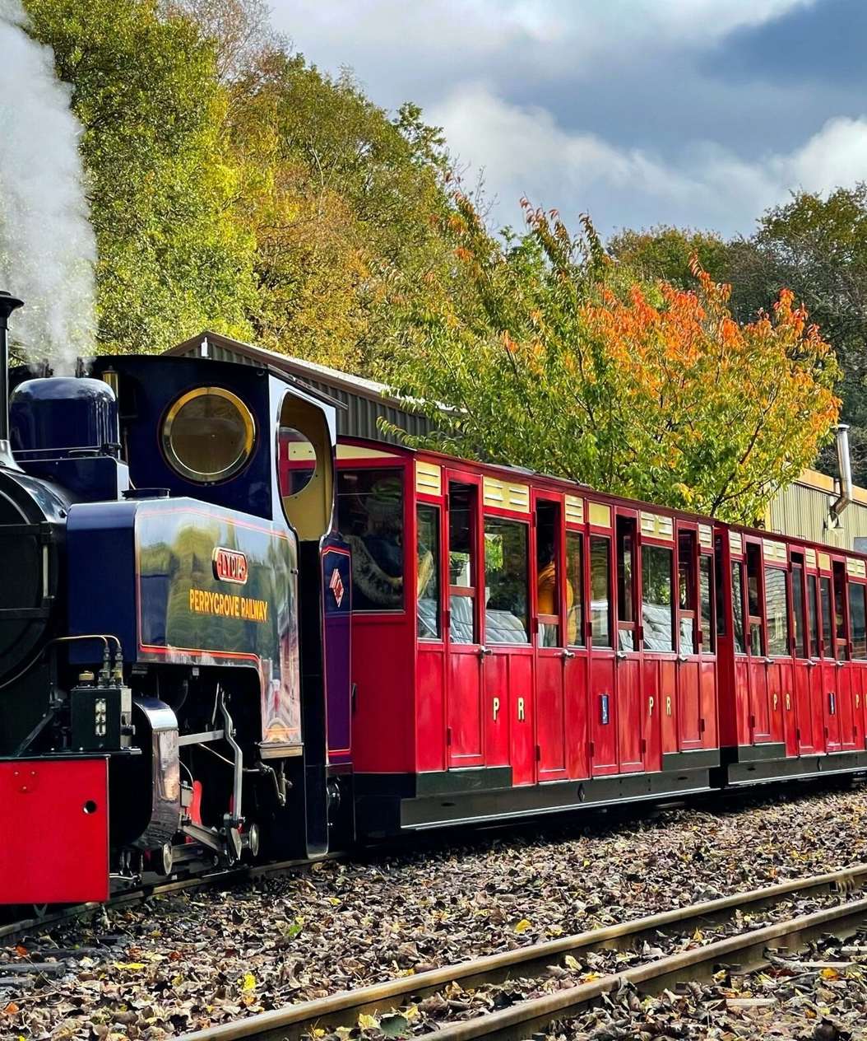
UK Train Rides Analysis
An introductory slide providing an overview of the analysis of train rides in the United Kingdom

Slide 2
Presentation Overview
Introduction
Overview of the purpose and background of the analysis
Project Overview & Objectives
High-level description of the project and its goals
Steps of the Project
Outline of the data collection, preprocessing, modeling, analysis, visualization, and conclusion process
Data (Raw, Preprocessing, Modeling, Analysis)
Details on the raw data, data cleaning and feature engineering, modeling techniques, and data analysis insights
Data Visualizations
Exploration of various data visualizations to uncover travel behavior, journey performance, pricing trends, geographic and temporal patterns
Conclusion & Recommendations
Summary of key insights and suggestions for operational improvements

Slide 3

The purpose of this analysis is to gain a comprehensive understanding of the UK train rides landscape. The background provides context on the importance of the UK train system, its role in the country's transportation network, and the need for data-driven insights to improve its operations and service quality.

Slide 4
Project Overview
High-level Description
Dataset Source
Dataset Scope
This project aims to analyze UK train rides data to gain insights into travel behavior, journey performance, pricing trends, and geographic and temporal patterns. The analysis will help identify areas for operational improvements and enhance the overall passenger experience.
The dataset used for this analysis was obtained from the UK Department of Transport, which provides comprehensive data on train journeys across the country.
The dataset covers a year's worth of train journey data, including information on ticket purchases, travel times, delays, and other relevant metrics.

Slide 5
Project Objectives
Understanding travel behavior
Analyze passenger preferences, purchasing patterns, and usage of different ticket classes and types to gain insights into overall travel behavior.
Evaluating journey performance
Assess on-time performance, common reasons for delays, delay trends across different routes, times of day, and days of the week to identify areas for improvement.
Analyzing pricing trends
Examine the relationship between ticket class/type and pricing, refund trends, and payment method preferences to optimize the pricing structure and payment options.
Discovering geographic and temporal patterns
Identify the most used stations and routes, as well as seasonal variations in ticket sales and delay patterns to inform service planning and resource allocation.
Recommending operational improvements
Provide data-driven recommendations to enhance the overall efficiency and reliability of the UK train system, focusing on areas such as scheduling, resource management, and customer experience.

Slide 6






Steps of the Project
Data Collection
Preprocessing
Modeling
Analysis
Visualization
Conclusion
Gather the necessary data on UK train rides, including information on ticket purchases, journey details, and delay reports. Ensure the dataset is comprehensive and representative of the train network.
Clean and prepare the raw data for analysis. This may involve handling missing values, removing duplicates, and converting data into a standardized format. Feature engineering may also be performed to create new variables that provide additional insights.
Depending on the analysis objectives, apply appropriate modeling techniques such as classification, clustering, or regression to uncover patterns and relationships within the data. Utilize relevant tools and frameworks like Pandas, Matplotlib, and others to facilitate the modeling process.
Perform in-depth analysis on the preprocessed data to derive meaningful insights. Calculate summary statistics, identify key patterns, and gain a comprehensive understanding of travel behavior, journey performance, pricing trends, and geographic and temporal patterns.
Create informative and visually appealing data visualizations to effectively communicate the insights and findings. Use a variety of chart types, such as bar charts, line charts, heatmaps, and scatter plots, to present the analysis results.
Summarize the key insights and findings from the analysis. Provide recommendations for operational improvements, such as optimizing ticket pricing, enhancing on-time performance, and addressing customer pain points. Discuss potential areas for future work and research.

Slide 7
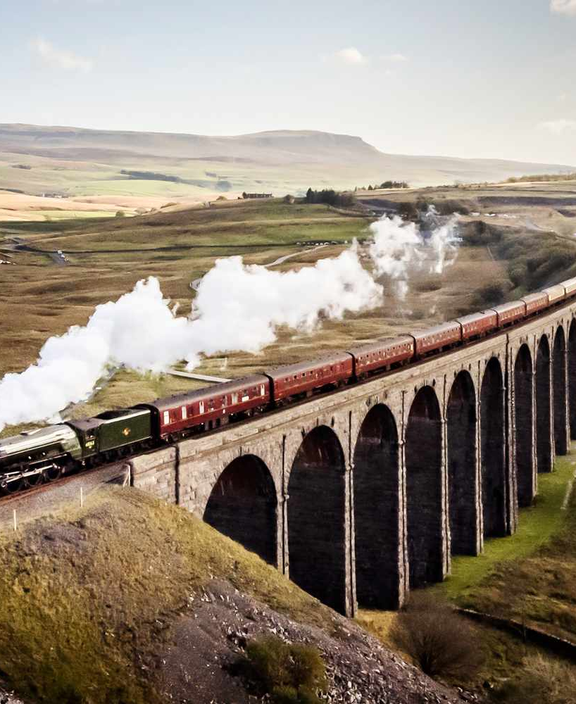
Raw Data
The dataset contains key information about train rides in the UK, including details on ticket purchases, journey performance, and pricing. The dataset has a size of approximately 50GB, with data in a CSV format. The data was sourced from the UK Department of Transport and covers a period of 3 years from 2018 to 2020.

Slide 8
Preprocessing
Data Cleaning
Handling Missing Values
Feature Engineering
This step involves identifying and addressing any errors, inconsistencies, or invalid data within the raw dataset. This may include handling missing values, removing duplicates, and correcting any formatting or syntax issues.
The dataset may contain missing values, which can be addressed through various techniques such as imputation (e.g., mean, median, or mode imputation), interpolation, or removing the affected rows or columns.
This step involves creating new features or transforming existing ones to improve the dataset's predictive power. This may include deriving new variables from the raw data, encoding categorical variables, and scaling numerical features.
Data Normalization
Exploratory Data Analysis
Normalizing the data helps ensure that all features are on a similar scale, which is important for many machine learning algorithms. This can be achieved through techniques like min-max scaling or standardization.
Performing an initial exploration of the dataset helps identify patterns, trends, and potential outliers. This analysis can guide the subsequent data preprocessing and modeling steps.

Slide 9
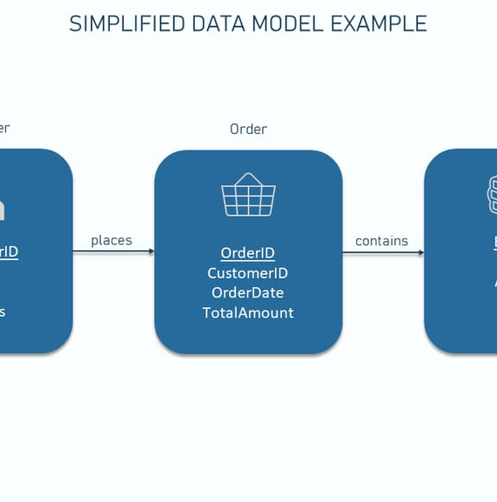
Data Modeling
The data modeling phase of the project involved the use of various techniques and tools to analyze the UK train ride data. The team leveraged Python libraries such as Pandas for data preprocessing and manipulation, and Matplotlib for data visualization.

Slide 10
Data Analysis
Summary Statistics
Key Patterns and Insights
Delay Analysis
Provided detailed summary statistics on key metrics such as journey duration, delay duration, ticket price, and passenger volume. Identified central tendency, dispersion, and distribution characteristics to understand the underlying patterns in the data.
Analyzed the data to uncover important trends and insights, such as the relationship between ticket class and price, the impact of time of day and day of the week on delays, the most frequently used payment methods, and the seasonal variations in ticket sales and delays.
Conducted a comprehensive analysis of delay incidents, including the most common reasons for delays, the routes with the highest delay frequency, and the trends in delay duration over time and by time of day.
Pricing Trends
Geographical Insights
Explored the pricing patterns in the dataset, examining the distribution of ticket prices by class and purchase method, as well as the trends in refunds and discounts across different ticket types.
Identified the most heavily utilized stations and routes, and analyzed the geographic distribution of delays to pinpoint areas that require operational improvements.

Slide 11

How are tickets most commonly purchased?
The analysis of ticket purchasing methods reveals that a significant portion of UK train passengers prefer to buy their tickets online. This trend suggests a growing reliance on digital platforms for transportation bookings, driven by the convenience and accessibility of online ticket sales.

Slide 12
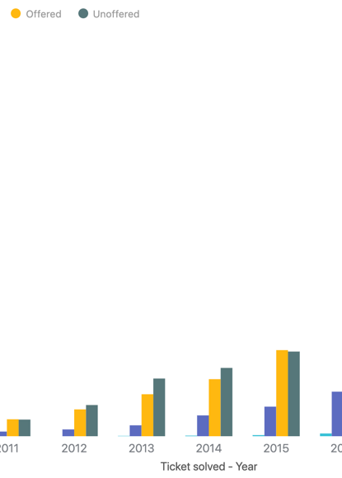
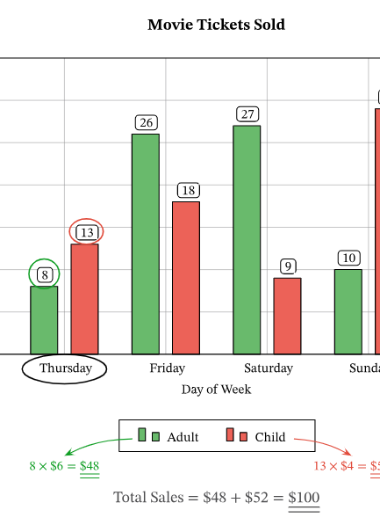
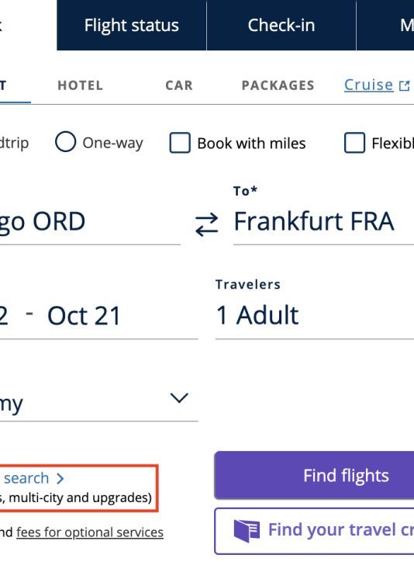
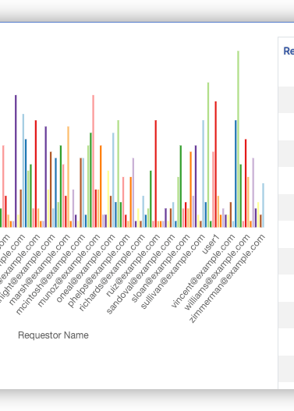
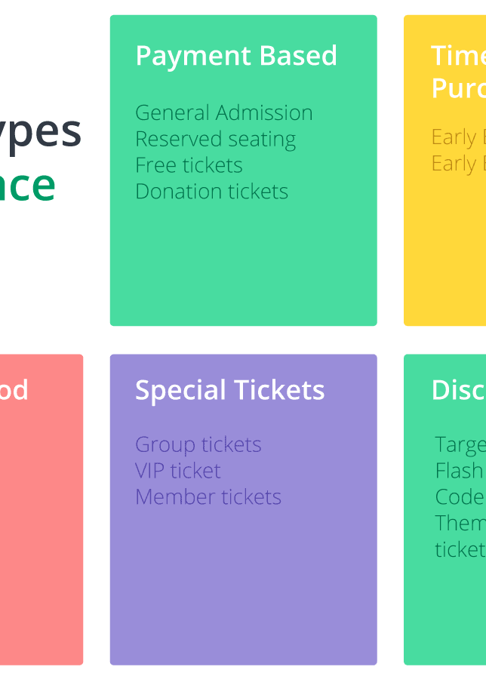
Most used ticket classes and types
Stacked Bar Chart
Grouped Bar Chart
Ticket Class
Ticket Count
Ticket Type
A stacked bar chart to visualize the breakdown of ticket classes and types.
A grouped bar chart to compare the count of different ticket classes and types.
The x-axis should represent the different ticket classes.
The y-axis should represent the count or number of tickets for each class and type.
The different ticket types should be represented using different colors in the chart.

Slide 13

Proportion of passengers using railcards
The proportion of passengers using railcards in the UK train system is an important metric to understand travel behavior. Railcards offer discounts and benefits to specific passenger groups, such as students, seniors, or those with disabilities, which can impact ticket purchasing decisions and travel patterns.

Slide 14
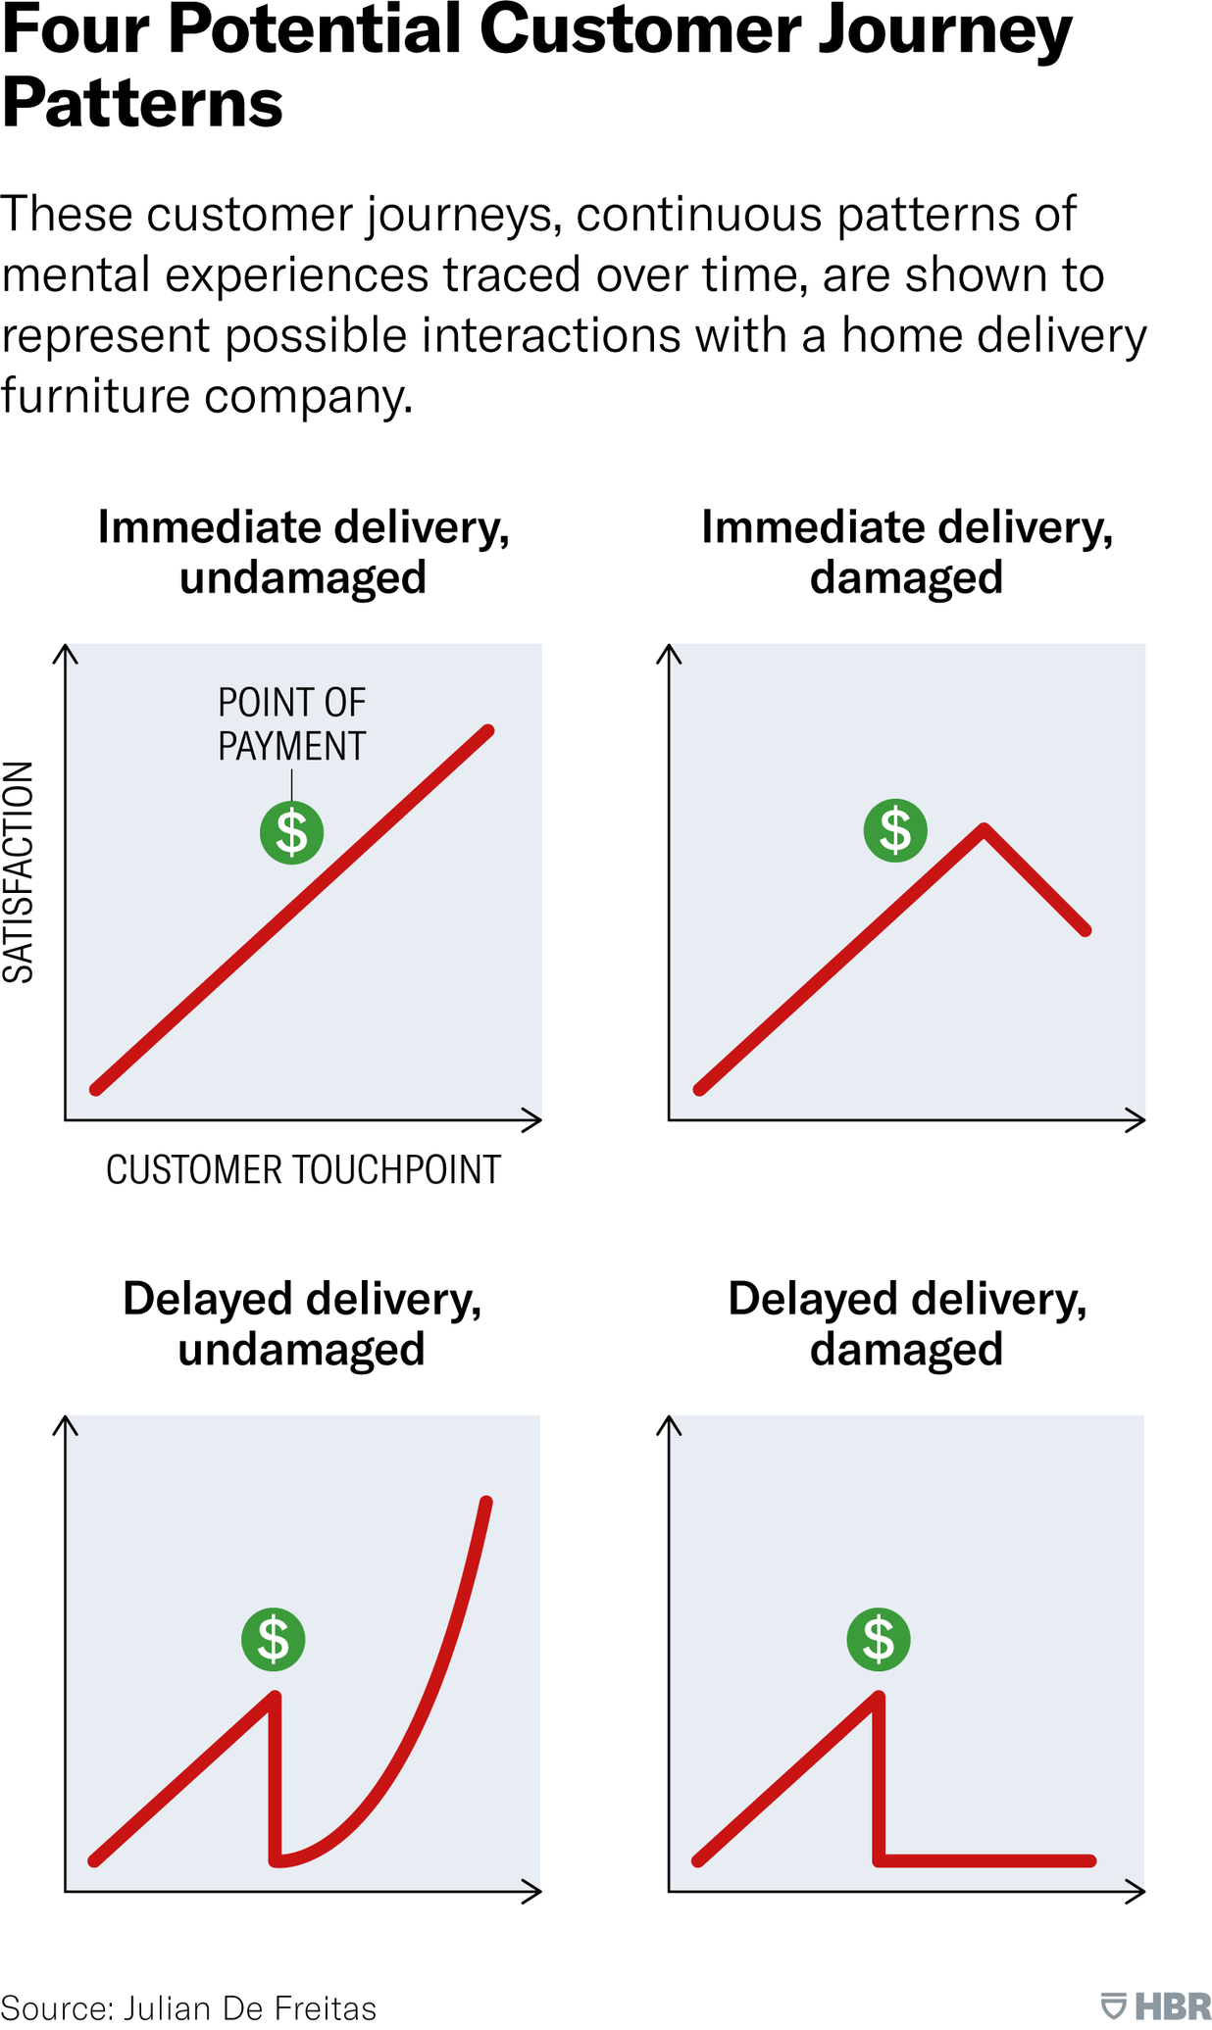
On-time vs. Delayed journeys
This slide examines the on-time performance of UK train journeys. The data shows the proportion of journeys that were completed on-time versus those that experienced delays.

Slide 15
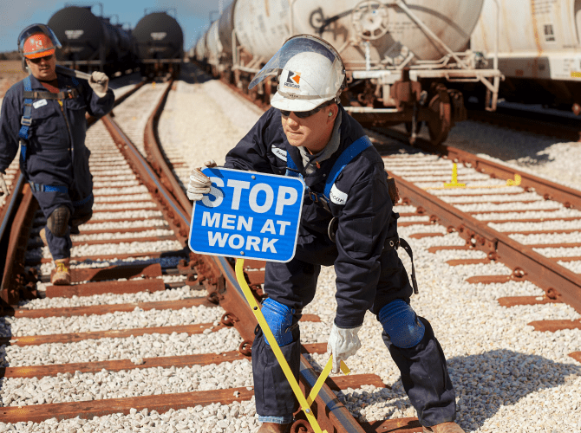
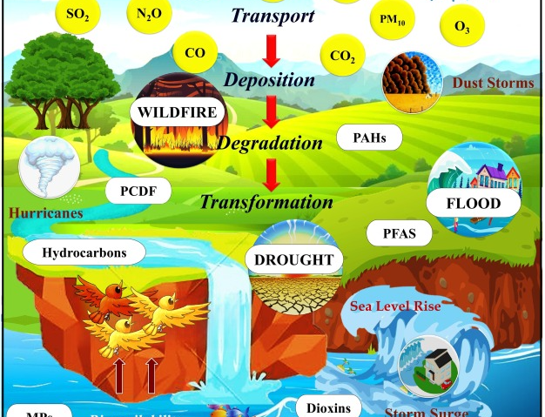
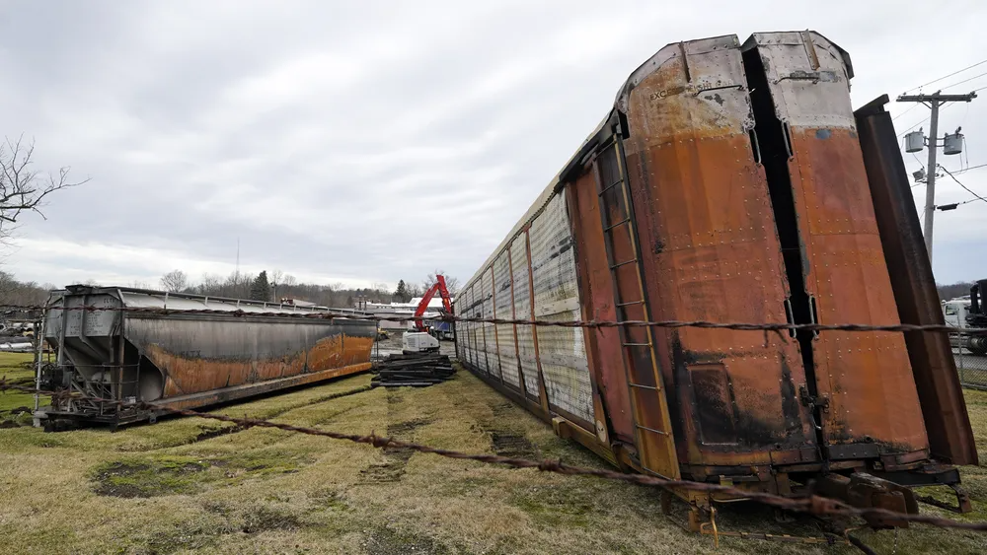


Common reasons for delays
Track Maintenance
Weather Conditions
Equipment Failure
Signaling Problems
Passenger-related Incidents
Horizontal bar chart showing the percentage of delays caused by track maintenance activities
Horizontal bar chart depicting the share of delays attributed to adverse weather conditions like heavy rain, snow, or high winds
Horizontal bar chart illustrating the proportion of delays stemming from mechanical issues or equipment malfunctions on trains
Horizontal bar chart showing the percentage of delays caused by signaling system failures or errors
Horizontal bar chart depicting the share of delays attributed to passenger-related incidents like medical emergencies, trespassing, or unruly behavior

Slide 16
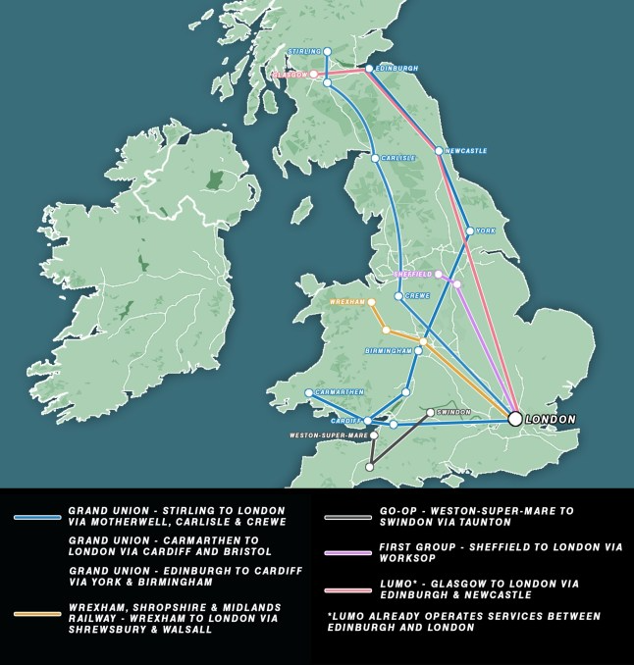
Most frequently delayed routes
The most frequently delayed routes in the UK train system are visualized using a bar chart or heatmap. This analysis helps identify the specific routes that experience the highest levels of delays, which can inform targeted operational improvements to enhance journey performance.

Slide 17
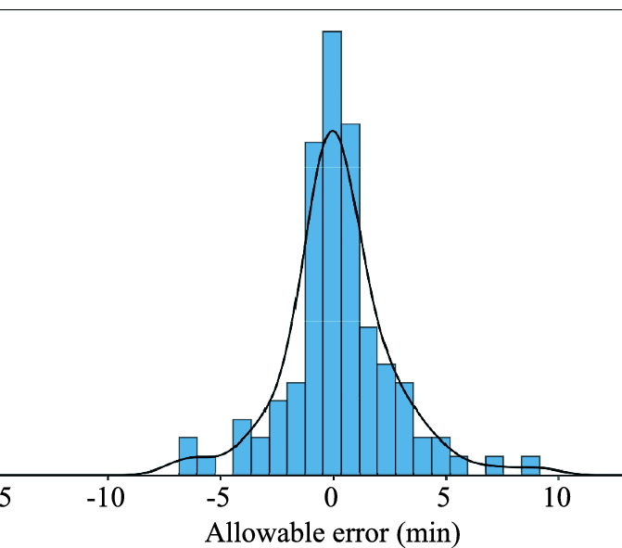
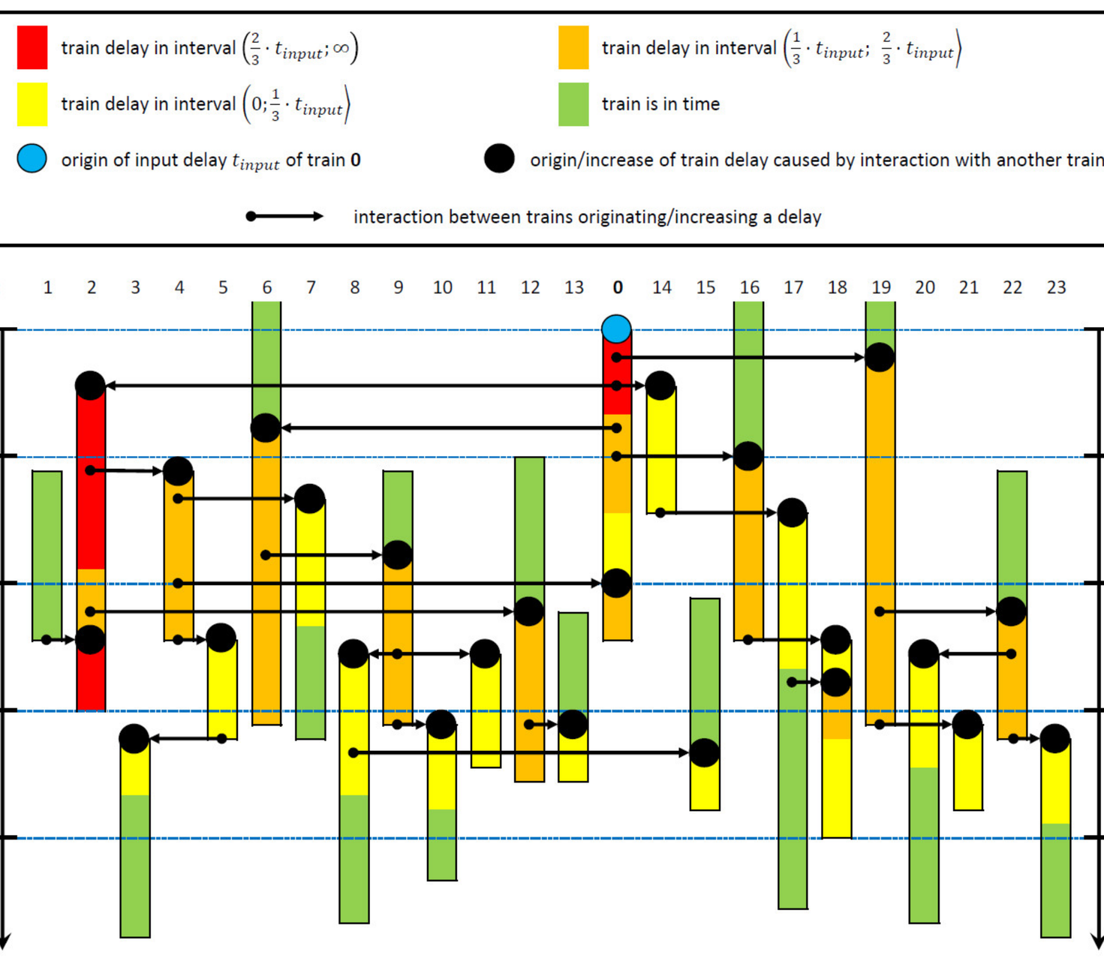
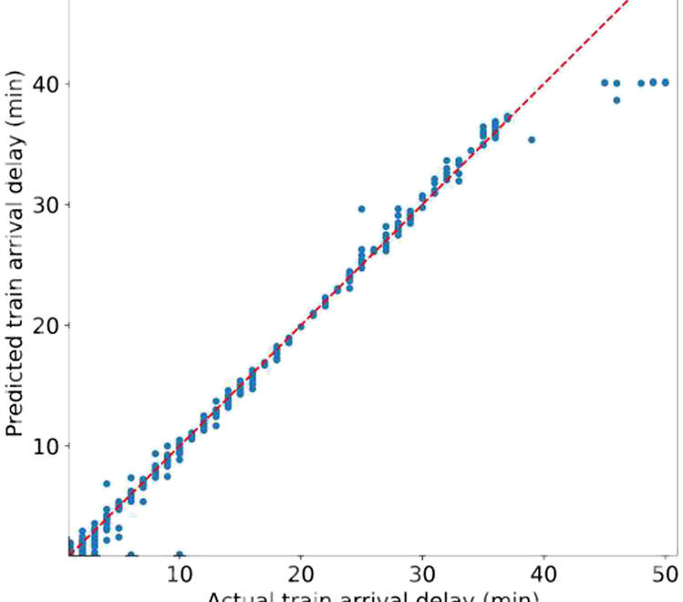
Average delay duration
Histogram
Box Plot
Scatter Plot
A histogram showing the distribution of delay durations across all train journeys
A box plot visualizing the statistical summary of delay durations, including the median, quartiles, and outliers
A scatter plot displaying the relationship between delay duration and other factors such as journey distance or time of day

Slide 18
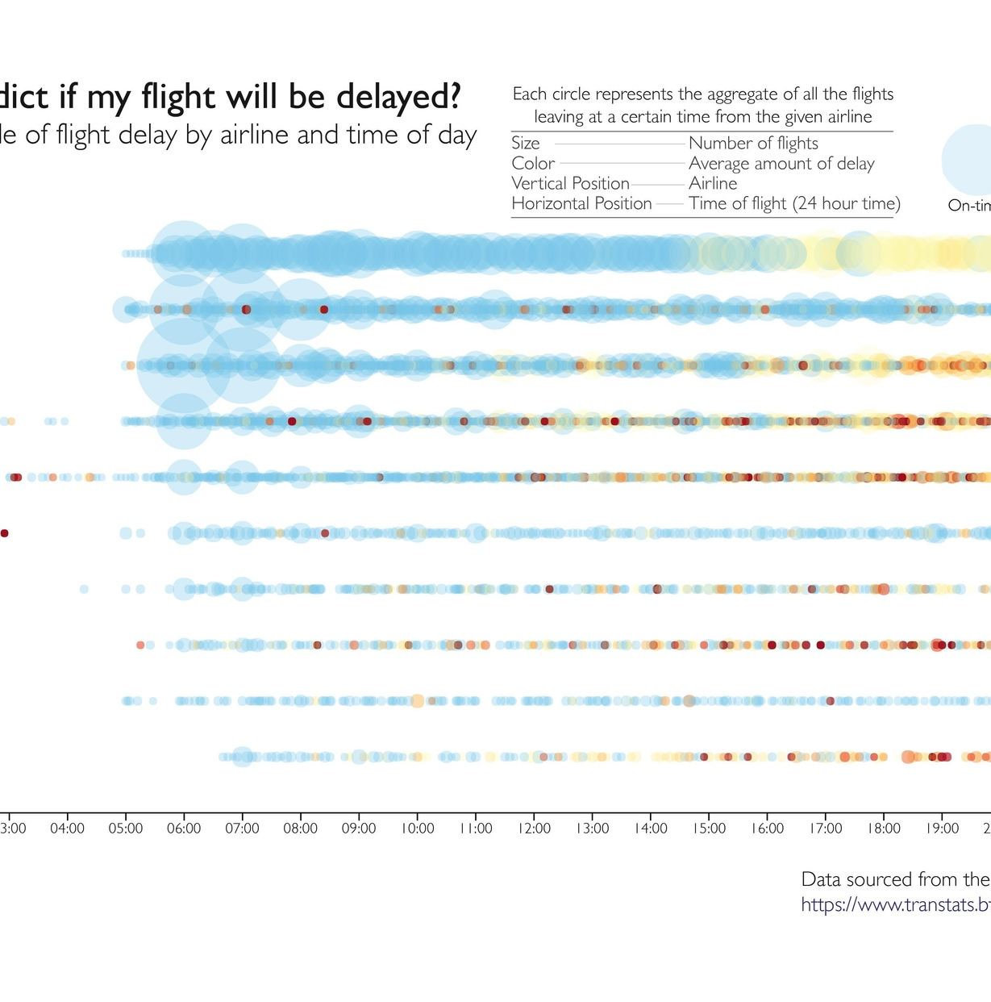
Delay trends by time of day
The

Slide 19
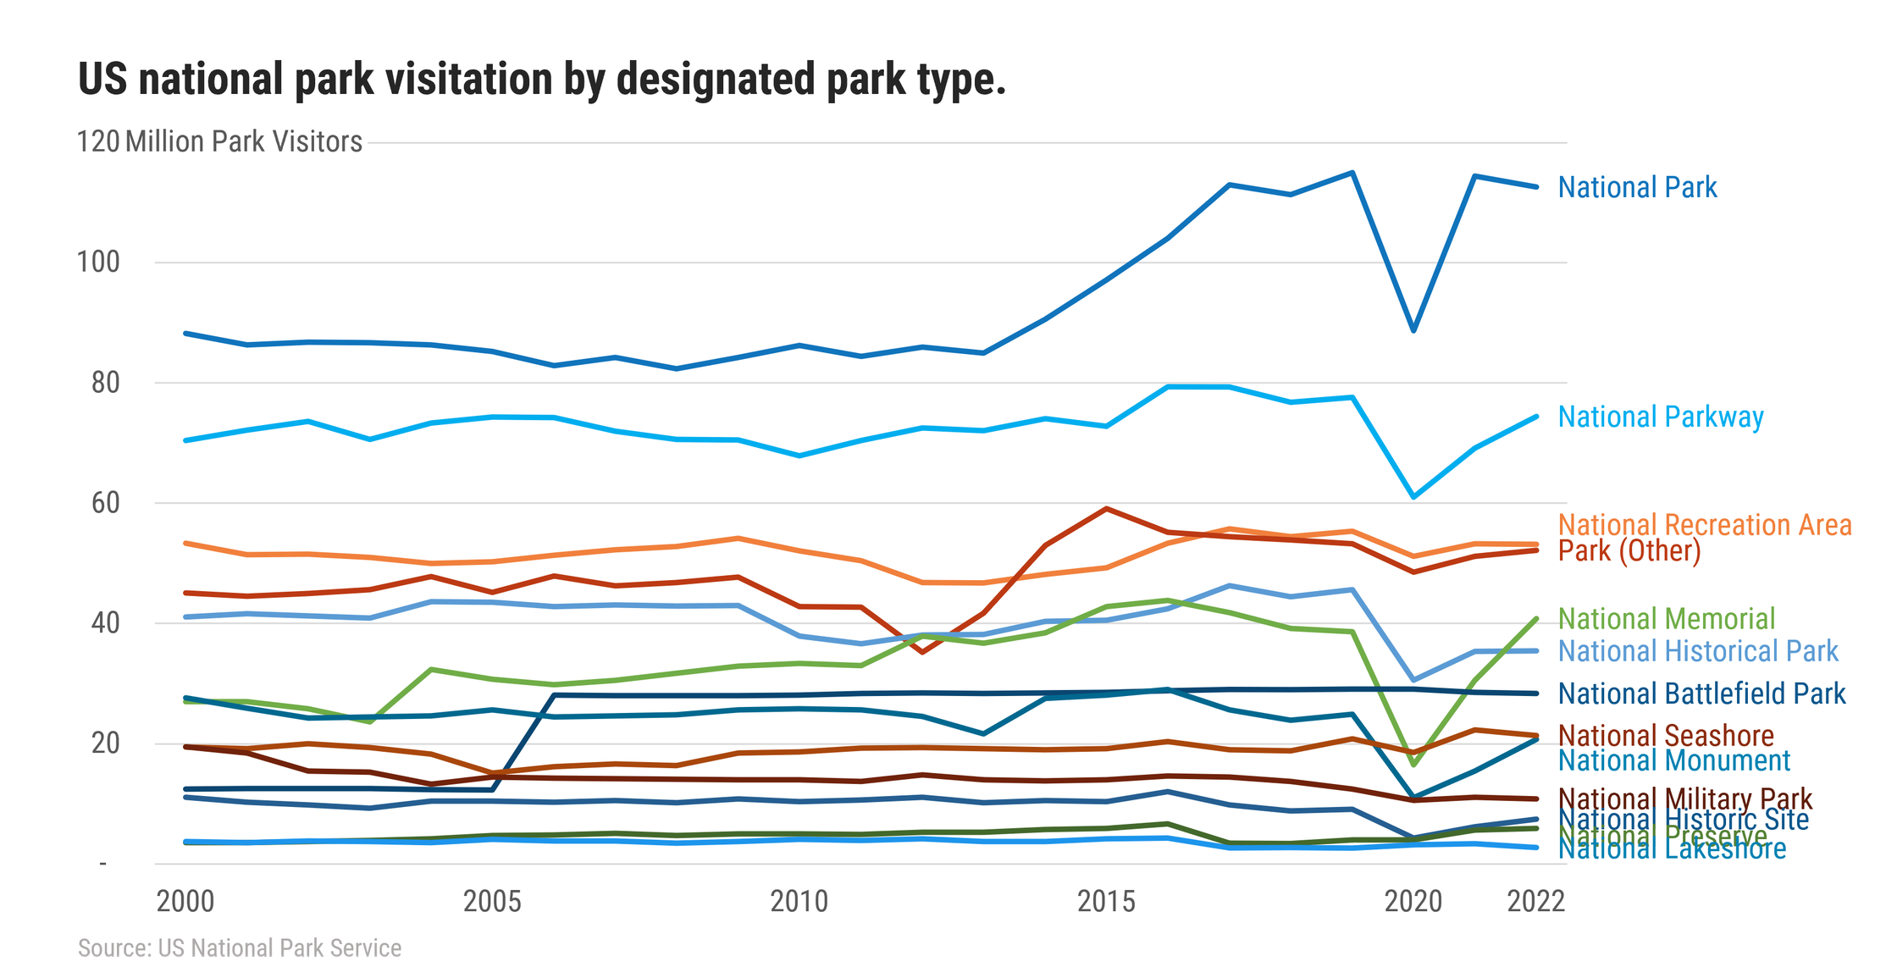
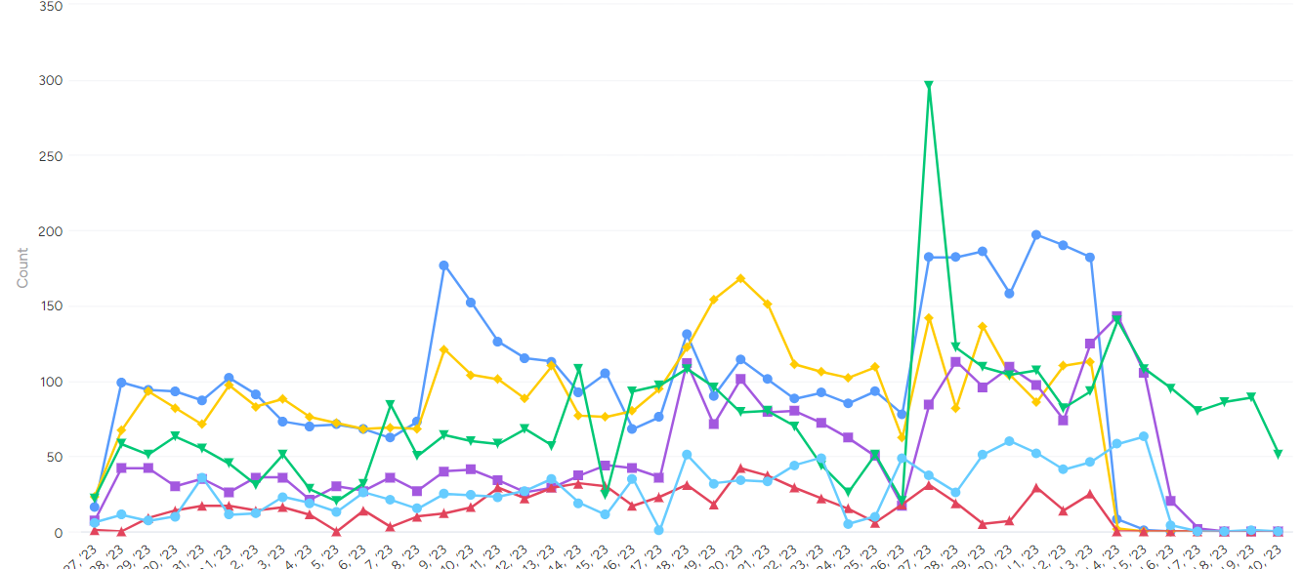
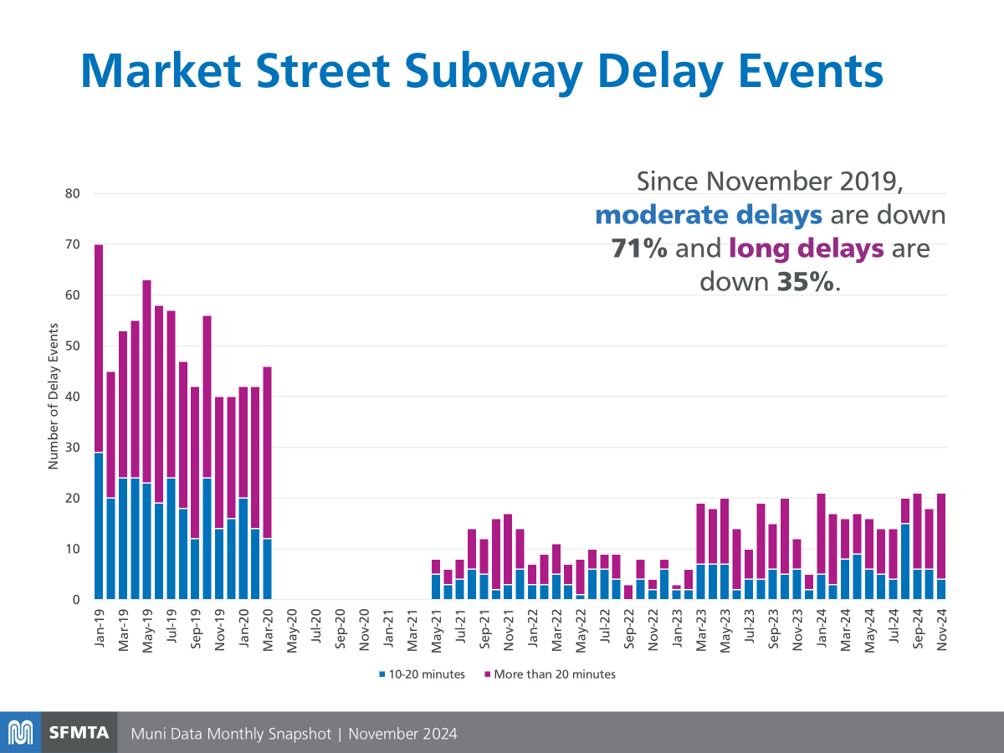
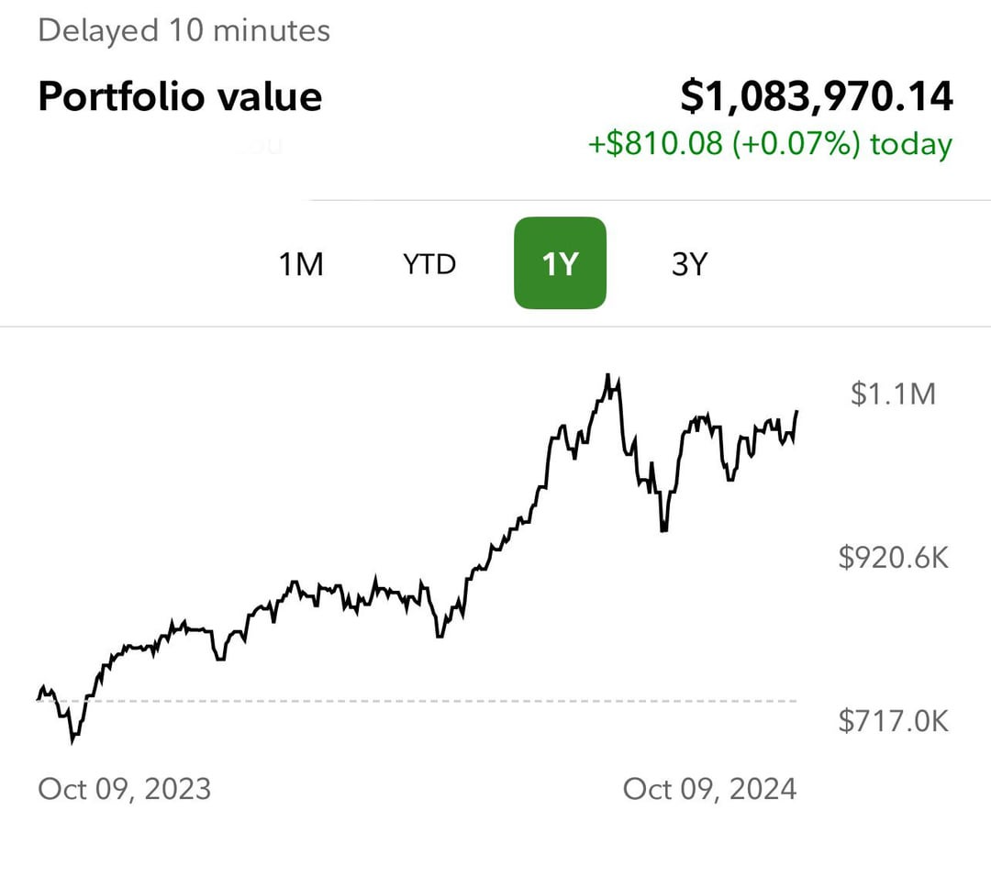
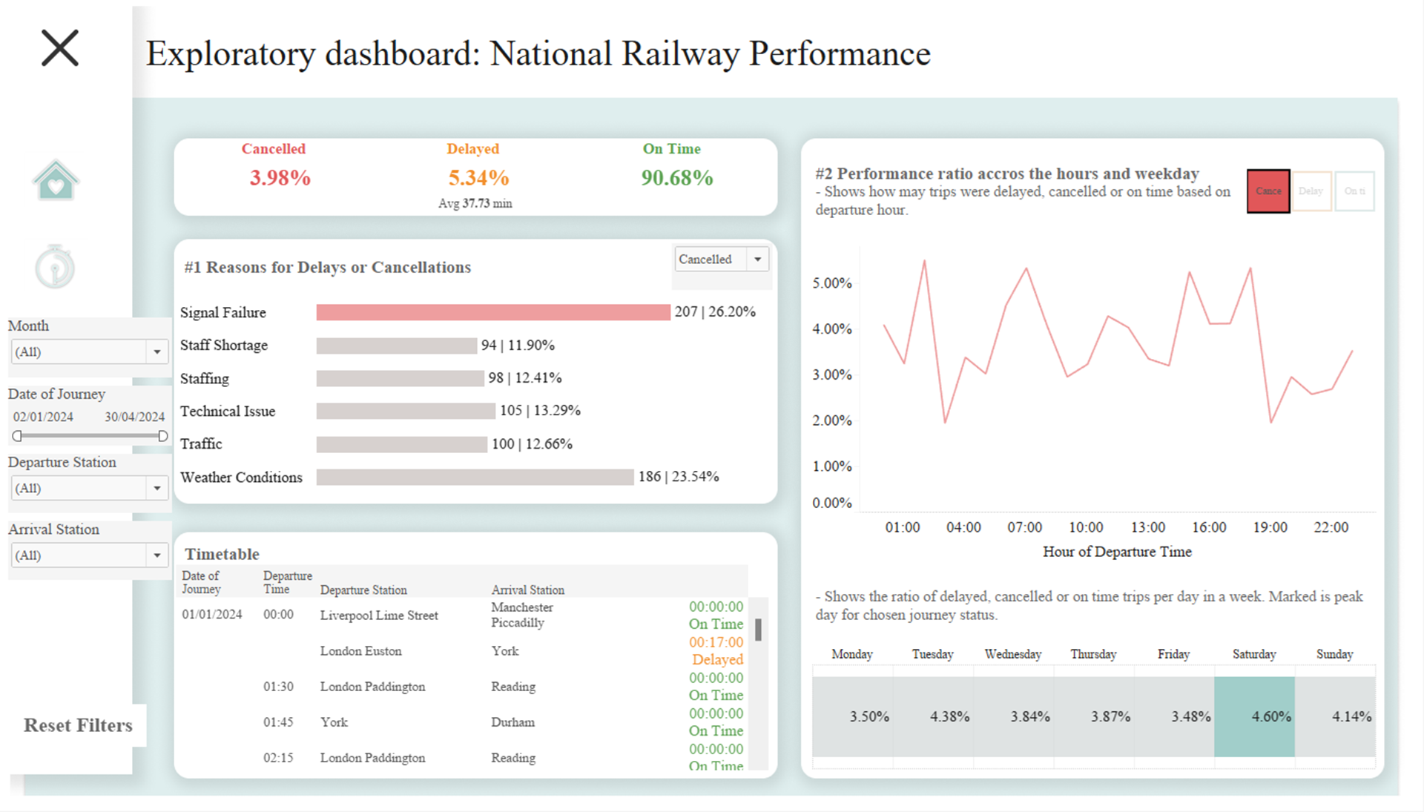
Delay trends by day of the week
Delay Trends by Day of the Week
Monday Delays
Tuesday Delays
Wednesday Delays
Thursday Delays
Friday Delays
Weekend Delays
Line chart segment showing the delay percentage trend for Friday
Line chart segment showing the delay percentage trend for Monday
Line chart segment showing the delay percentage trend for Tuesday
Line chart segment showing the delay percentage trend for Wednesday
Line chart segment showing the delay percentage trend for Thursday
Line chart segments showing the delay percentage trends for Saturday and Sunday
Line chart showing the percentage of delayed journeys by day of the week

Slide 20

Most used payment methods
The analysis of payment methods used by UK train passengers reveals that credit/debit cards are the most commonly used form of payment, accounting for a significant portion of overall ticket purchases. This insight can help train operators optimize their payment infrastructure and offer seamless payment options to cater to customer preferences.

Slide 21
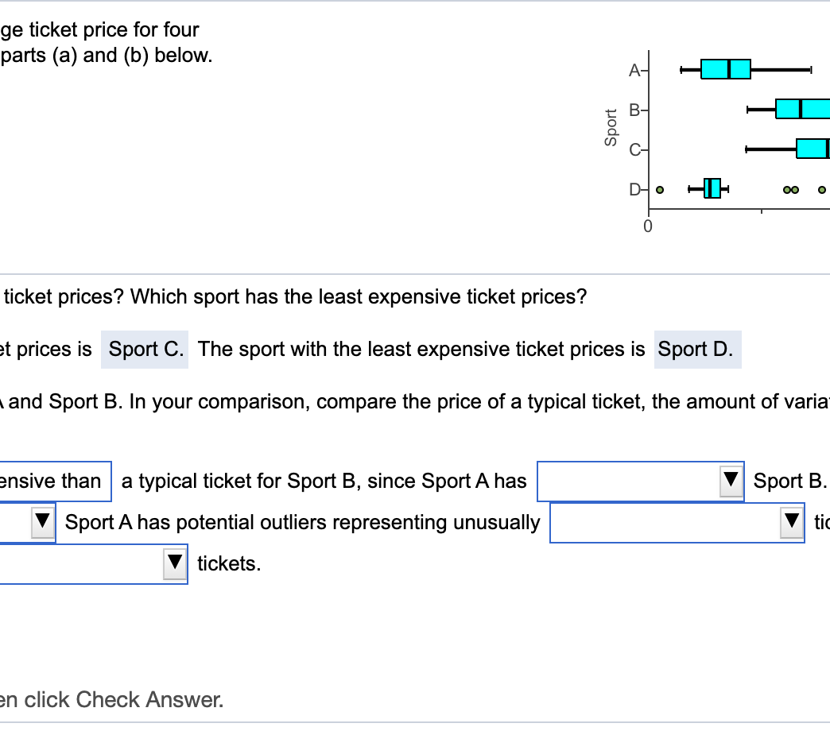
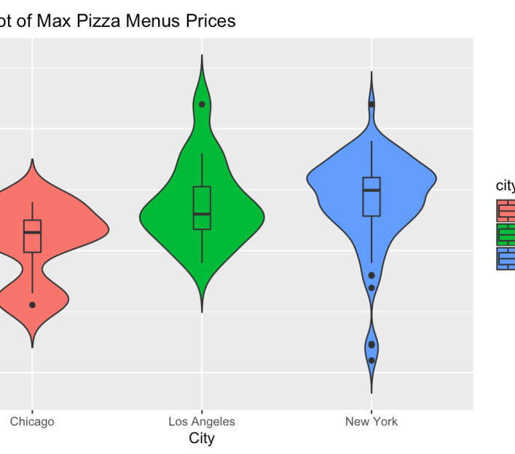
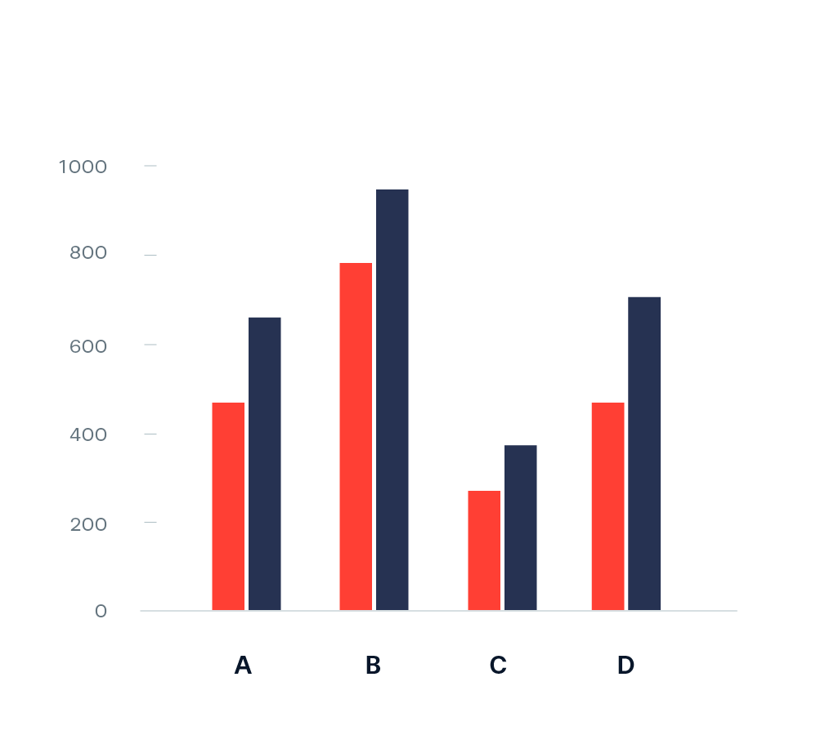
Ticket class/type vs. price
Box Plot
Violin Plot
Grouped Bar Chart
A box plot displaying the distribution of ticket prices across different ticket classes and types.
A violin plot showing the probability density distribution of ticket prices for each ticket class and type.
A grouped bar chart comparing the average ticket prices for different ticket classes and types.

Slide 22
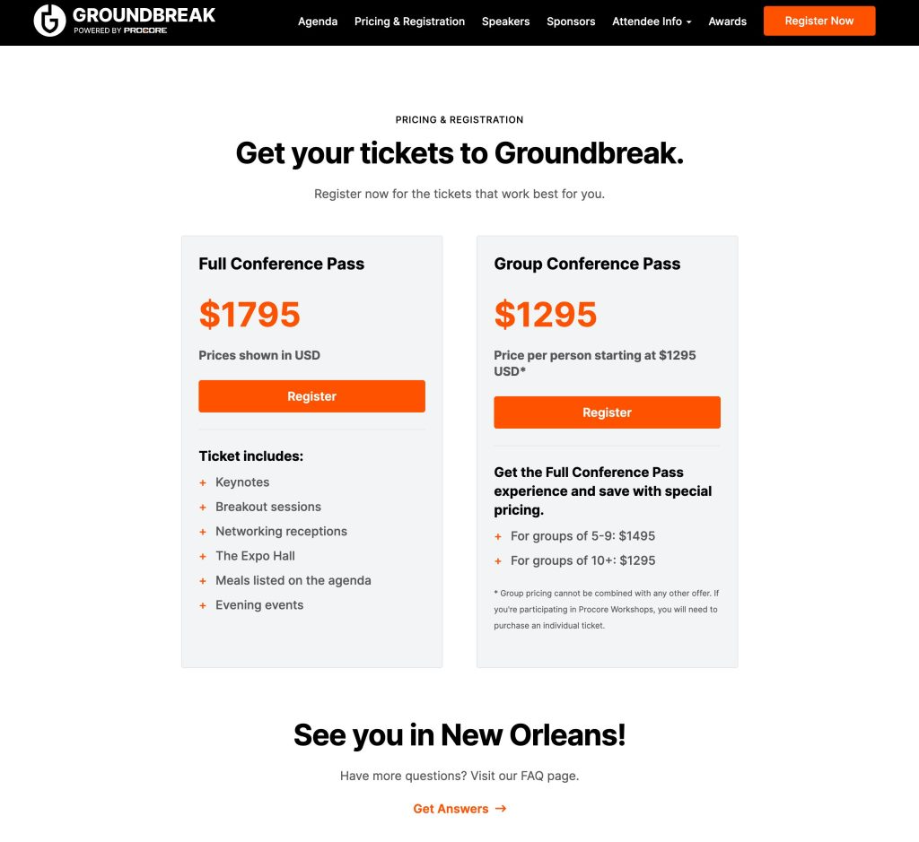
Price distribution by class/method
This slide examines the distribution of ticket prices across different classes and payment methods. The analysis aims to provide insights into the pricing structure of the UK train system and identify any potential discrepancies or patterns in the pricing strategies.

Slide 23
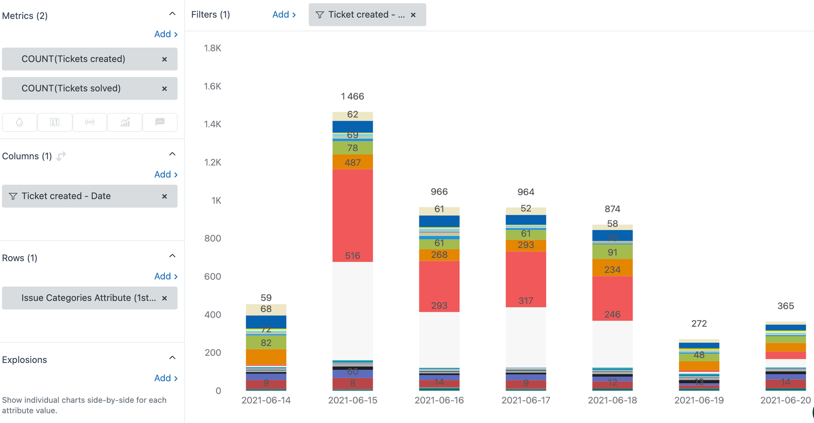
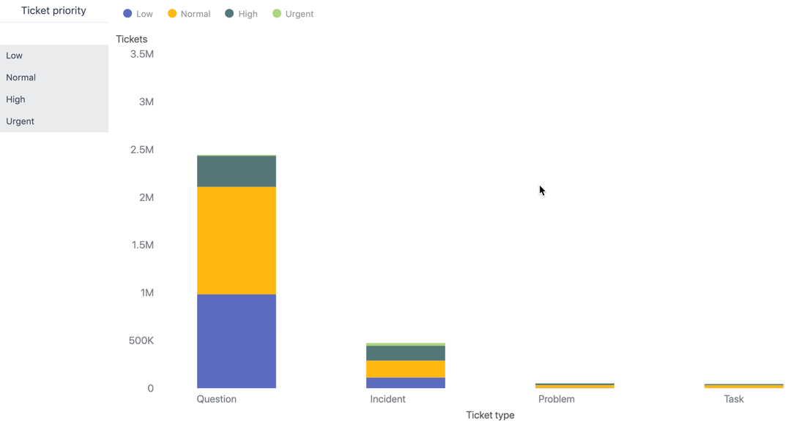
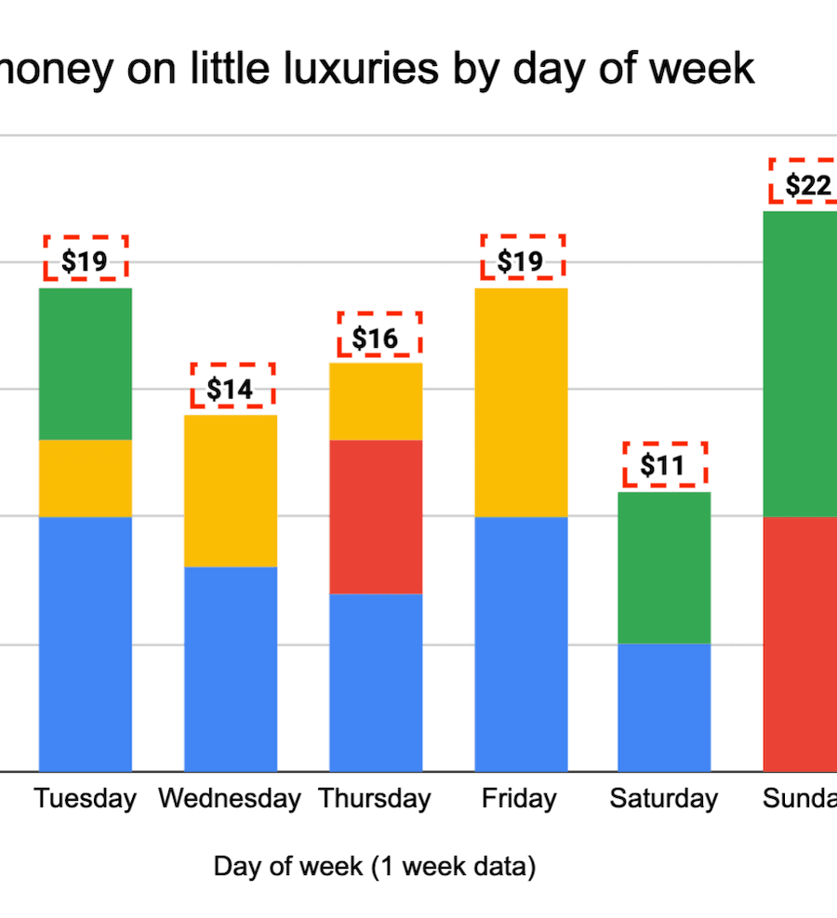
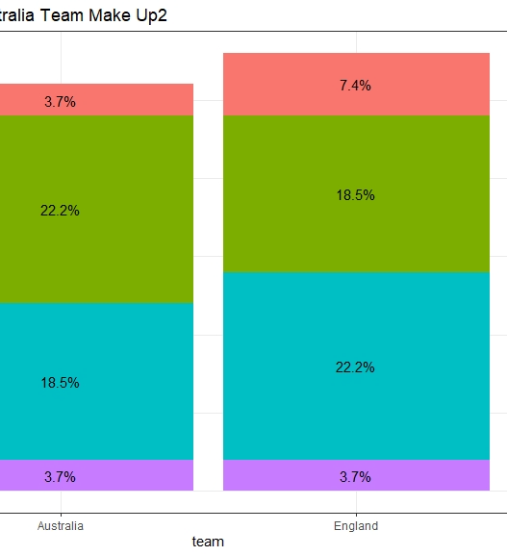
Refund trends by ticket/payment type
Stacked Bar Chart
Ticket Types
Payment Methods
Refund Percentages
A stacked bar chart showing the refund trends for different ticket and payment types.
The x-axis displays the different ticket types, such as single, return, season, etc.
The stacked bars represent the different payment methods, such as cash, card, mobile, etc.
The height of each stack represents the percentage of refunds for that ticket and payment type combination.

Slide 24

Peak purchasing times (hourly)
This slide explores the hourly trends in train ticket purchases across the UK railway network. Understanding when passengers most frequently buy their tickets can help transportation providers optimize staffing, inventory management, and other operational aspects to cater to these demand patterns.

Slide 25
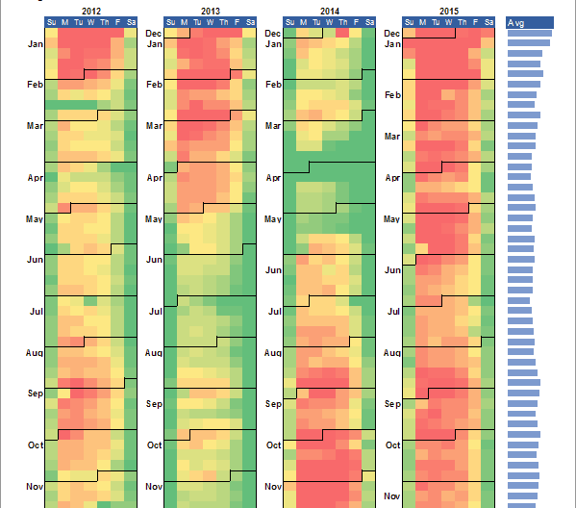
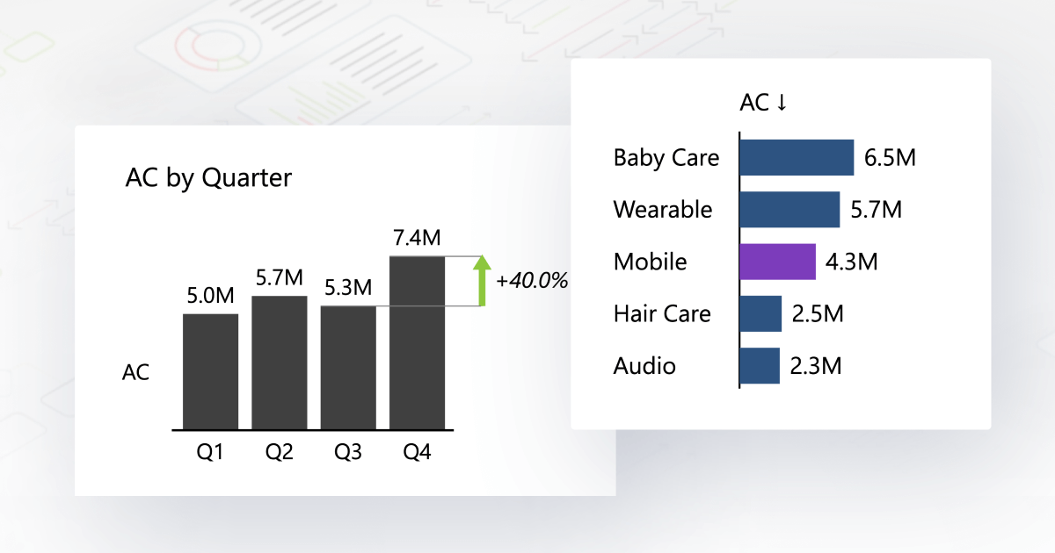
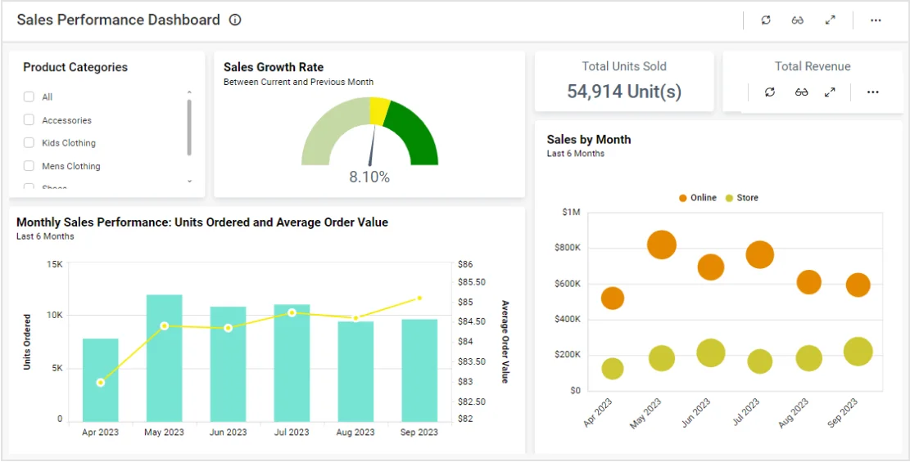
Highest ticket sales by day/month
Calendar Heatmap
Bar Chart
Combination Chart
A calendar heatmap that visualizes the highest ticket sales by day of the month.
A bar chart that displays the highest ticket sales by month of the year.
A combination chart that shows both the daily and monthly patterns of highest ticket sales.

Slide 26
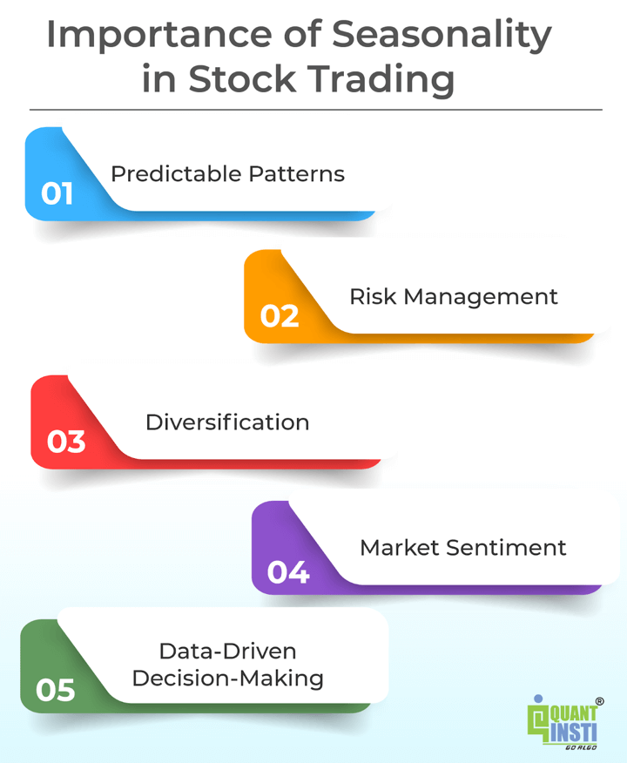
Seasonal delay vs. purchase pattern
This slide examines the seasonal patterns in train delays and ticket purchases. The line chart displays the monthly trends, highlighting how delays and ticket sales vary throughout the year. This insight can help the train operator identify peak demand periods and allocate resources accordingly to improve on-time performance and enhance the customer experience.

Slide 27
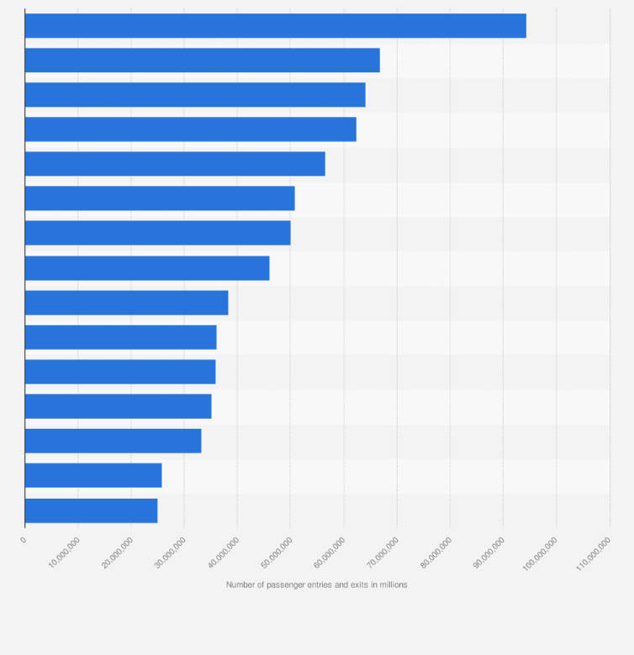
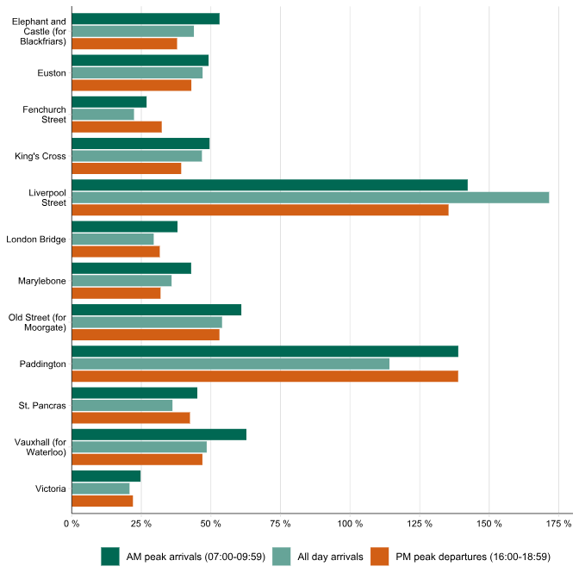
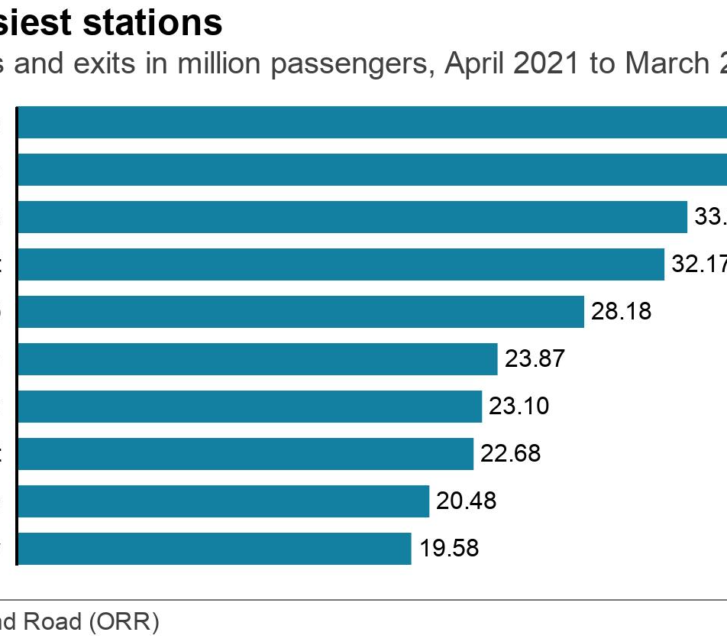
Most used stations
Top 10 Most Used Stations
Station Utilization by Region
Busiest Stations Over Time
Bar chart showing the top 10 most used train stations in the UK based on passenger volume
Bar chart comparing the usage of train stations across different regions in the UK
Line chart showing the changes in the usage of the top 5 busiest train stations in the UK over a period of time

Slide 28
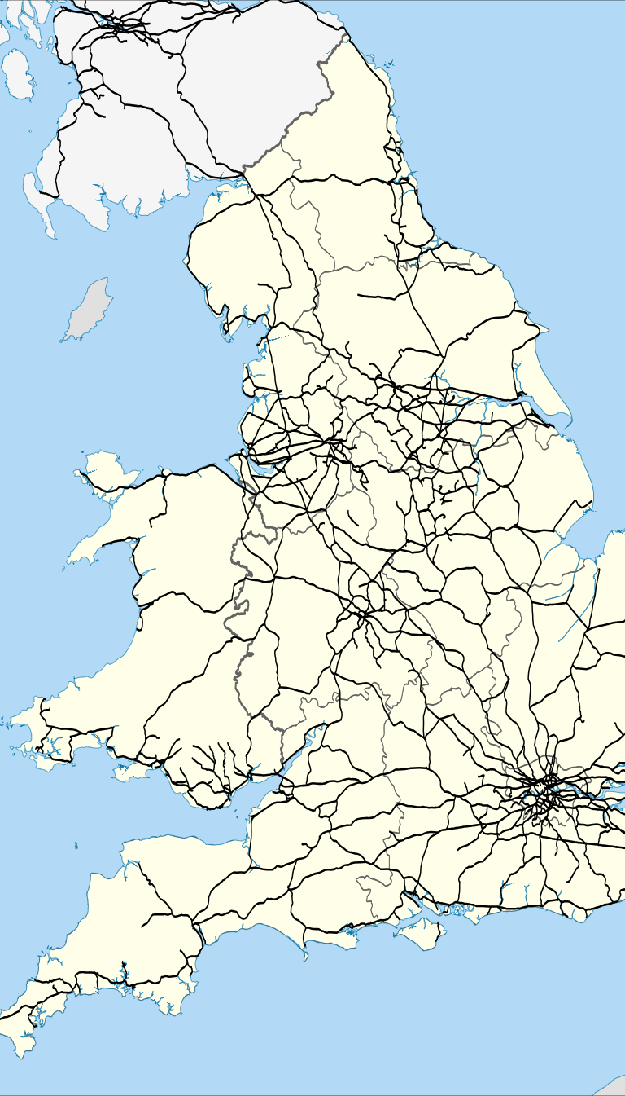
Busiest routes
The Busiest routes slide presents a Chord Diagram or Sankey Chart to visualize the most frequently traveled routes within the UK train network. This chart provides a clear representation of the connectivity and traffic flow between the various stations, allowing for a comprehensive understanding of the busiest segments of the rail system.

Slide 29
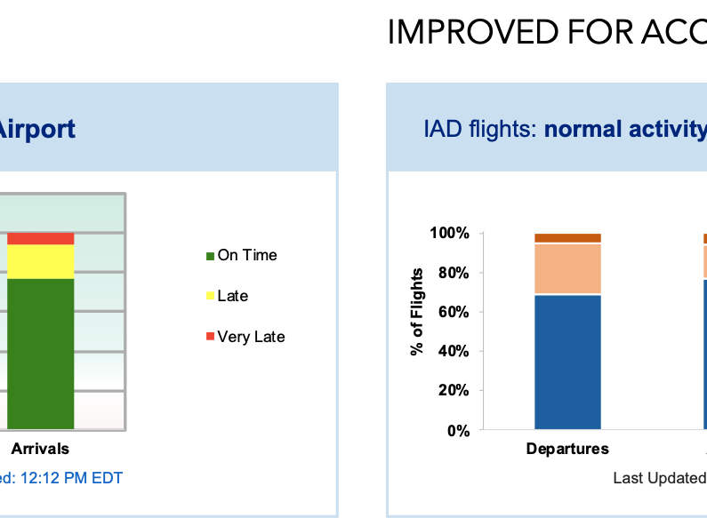
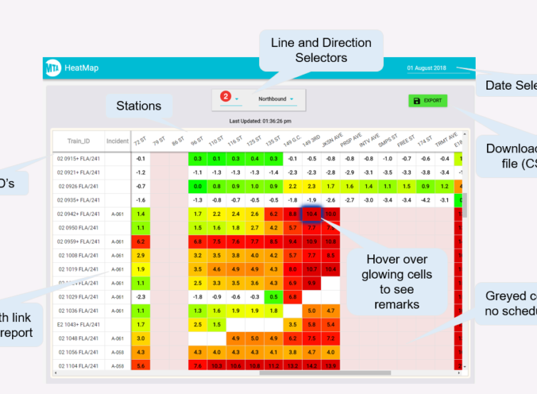
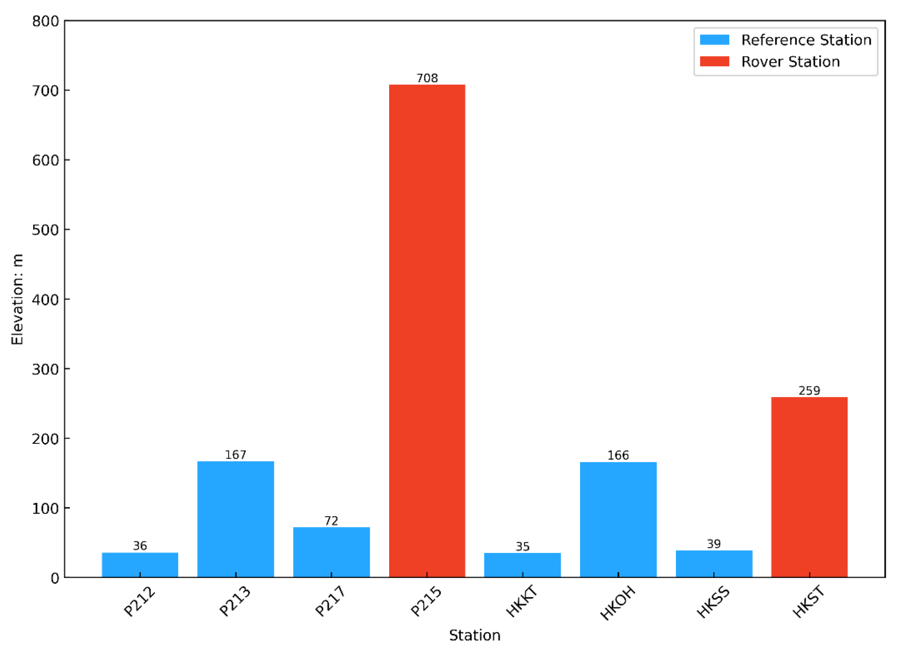
Stations with high delays
Bar Chart of Delayed Stations
Heatmap of Delay Hotspots
Delayed Station Performance Comparison
A bar chart showing the top stations with the highest delays, ranked by the number of delayed trains.
A heatmap visualization highlighting the geographic distribution of delayed stations, with darker shades indicating higher delay frequencies.
A side-by-side comparison of the delay performance for the top delayed stations, allowing for easy identification of the worst-performing stations.

Slide 30
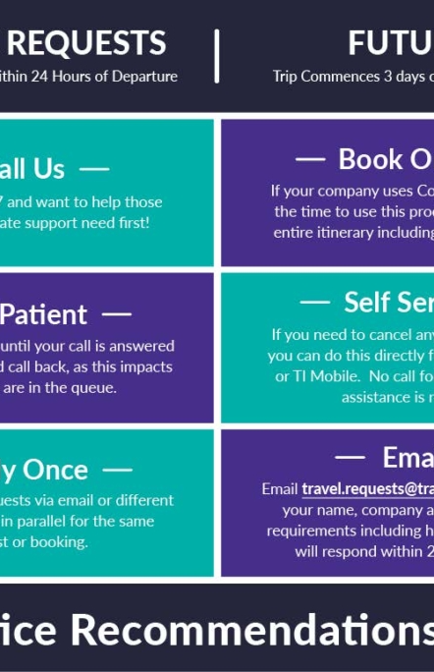
Delay vs. Journey Duration
The scatter plot illustrates the relationship between journey duration and delay experienced by passengers. This analysis can help identify patterns and dependencies between these two important metrics. By understanding how delay is correlated with journey duration, the transportation agency can identify opportunities to improve on-time performance and enhance the overall journey experience for train riders.

Slide 31
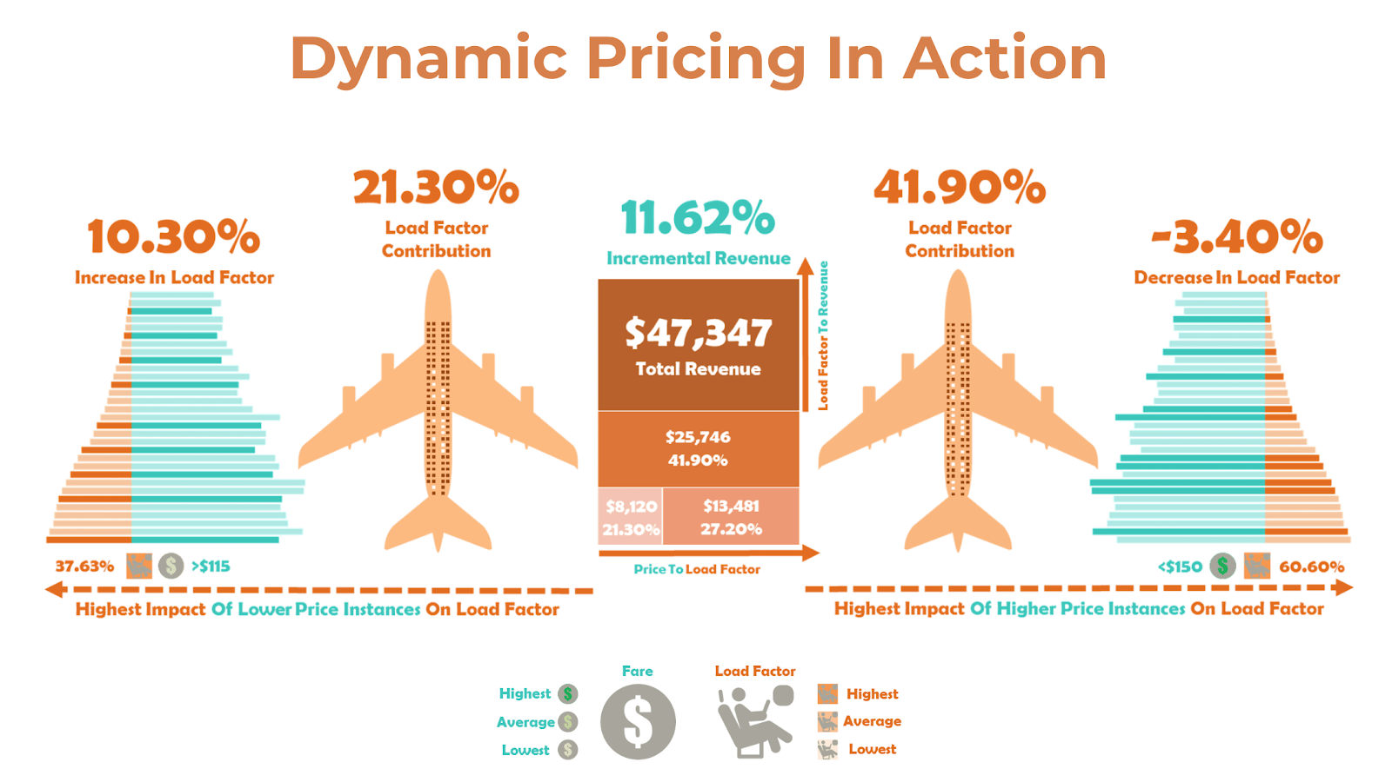
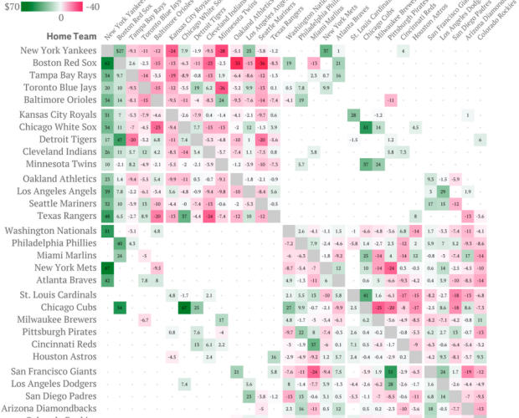
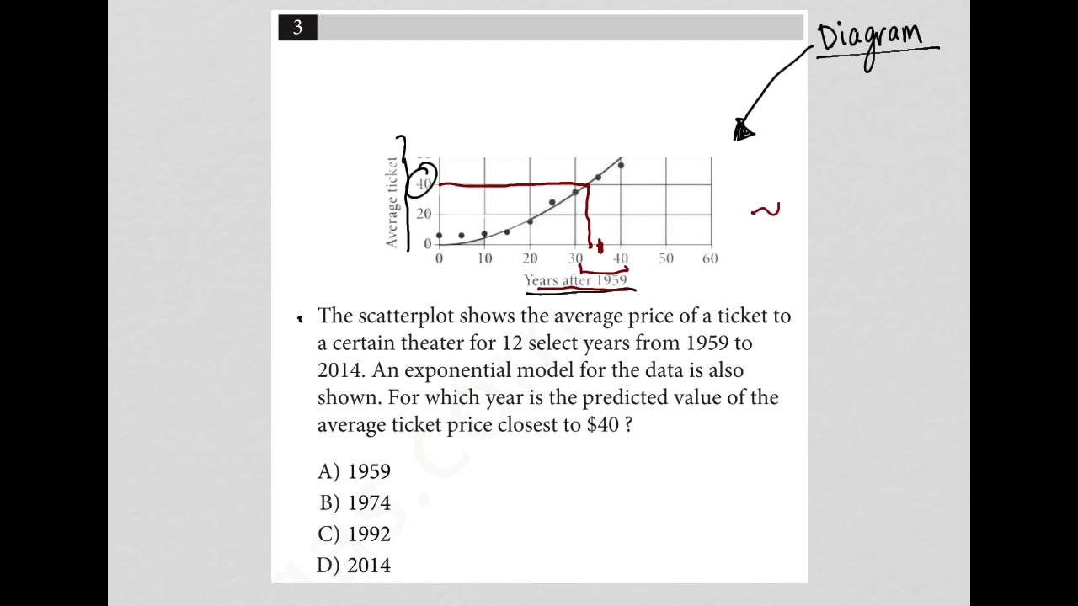
Ticket pricing optimization
Multi-Variable Line Chart
Heatmap
Scatter Plot
A line chart displaying the relationship between multiple factors, such as ticket class, purchase method, and price over time.
A heatmap visualization showing the price distribution across different ticket classes and purchase methods, highlighting the pricing trends.
A scatter plot illustrating the relationship between ticket price and journey duration, providing insights into pricing optimization.

Slide 32
Summary Recommendations
Average Delay
Worst Route
Best Station
Provides an overview of the average delay duration across all journeys
Identifies the route with the highest frequency and duration of delays
Highlights the station with the most reliable on-time performance
Refund Rate
Top Delay Reason
Analyzes the refund trends and identifies opportunities to improve customer satisfaction
Pinpoints the primary cause of delays, enabling targeted operational improvements

Slide 33
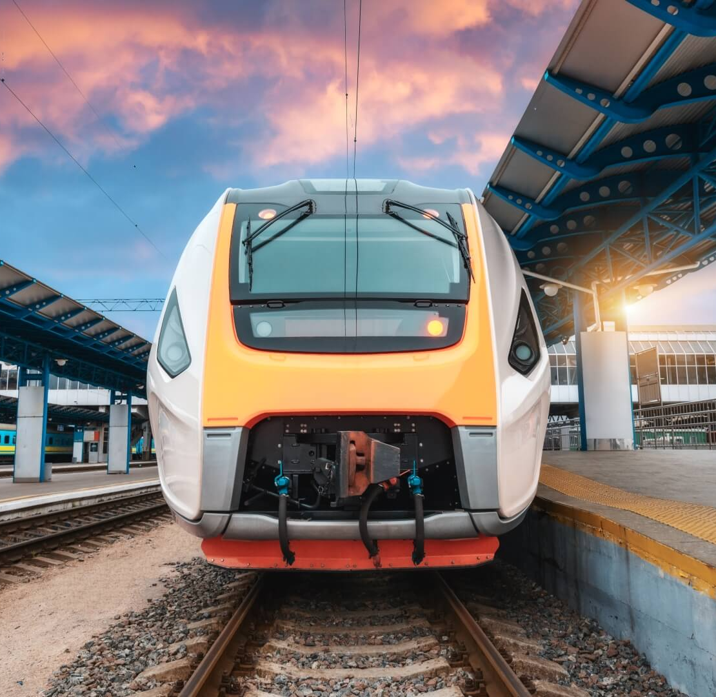
Conclusion & Recommendations
The Conclusion & Recommendations slide summarizes the key insights and provides suggestions for operational improvements based on the comprehensive analysis of UK train rides data. The analysis has uncovered valuable insights into travel behavior, journey performance, pricing trends, and geographic and temporal patterns, which can be leveraged to enhance the overall efficiency and customer experience of the UK train system.

Slide 34
UK Train Rides Analysis
The analysis of UK train rides provides valuable insights into travel behavior, journey performance, pricing trends, and geographic and temporal patterns. The key recommendations include optimizing ticket pricing, improving on-time performance, enhancing customer experience, and leveraging data-driven insights to drive operational efficiency. By implementing these recommendations, the UK train system can enhance its service quality, increase customer satisfaction, and meet the evolving transportation needs of the nation.

